Slide 1

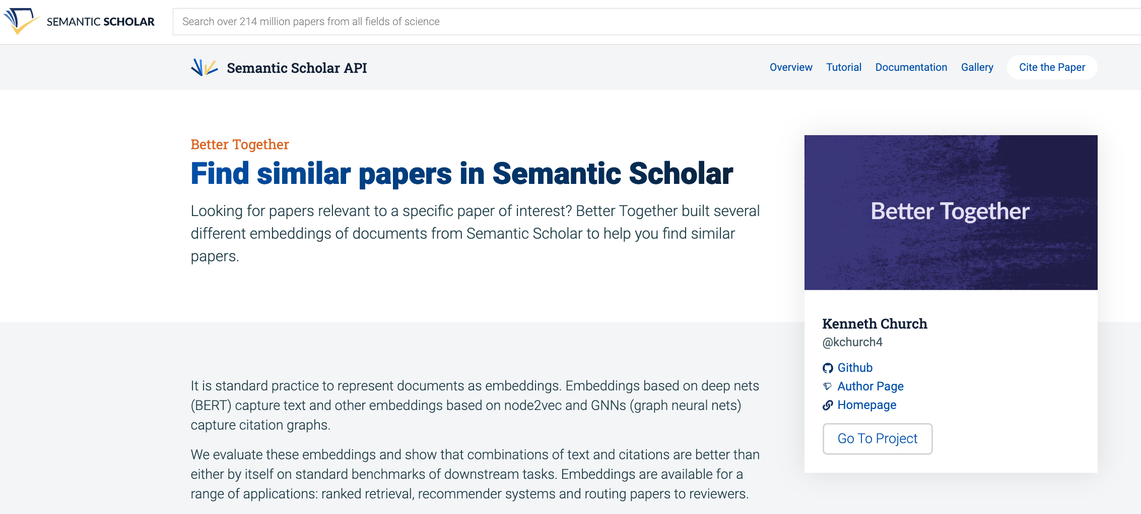
Better Together: Text + Context
Jan 18, 2024
https://www.semanticscholar.org/api-gallery/better-together

Slide 2
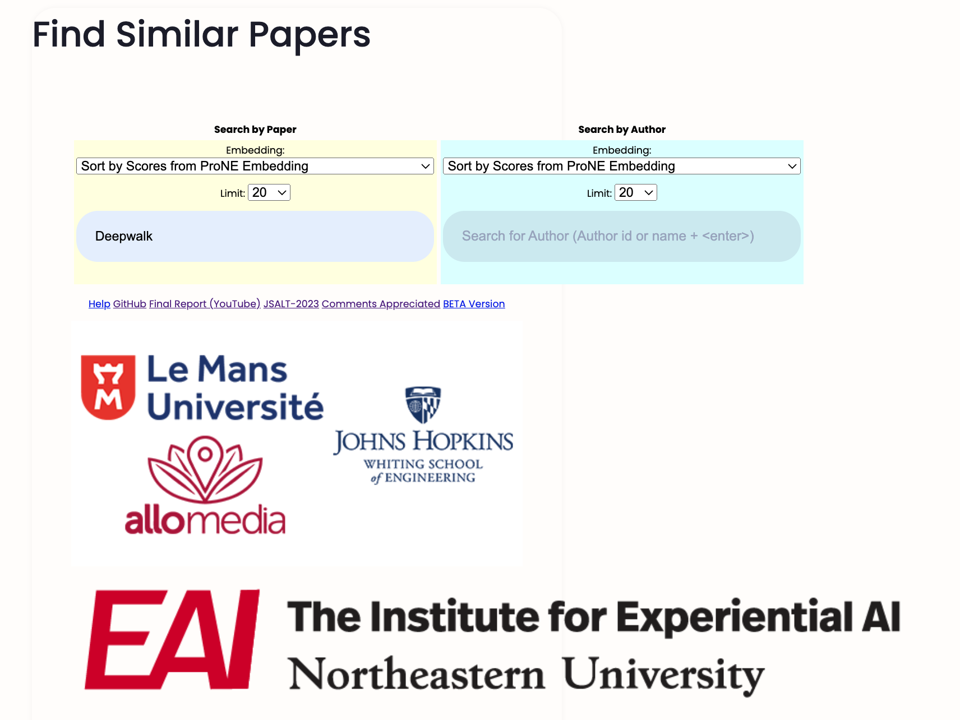

Slide 3
Recommendation Tasks
More than word overlap
For readers
What should I read?
For authors
What should I cite?
For conference organizers
Who should review what?
Many systems focus on ``relevance’’ (word overlap)
But we also want credibility
Don’t recommend papers that are buzz-word compliant
But not worth reading
(Most papers are never cited)

Slide 4
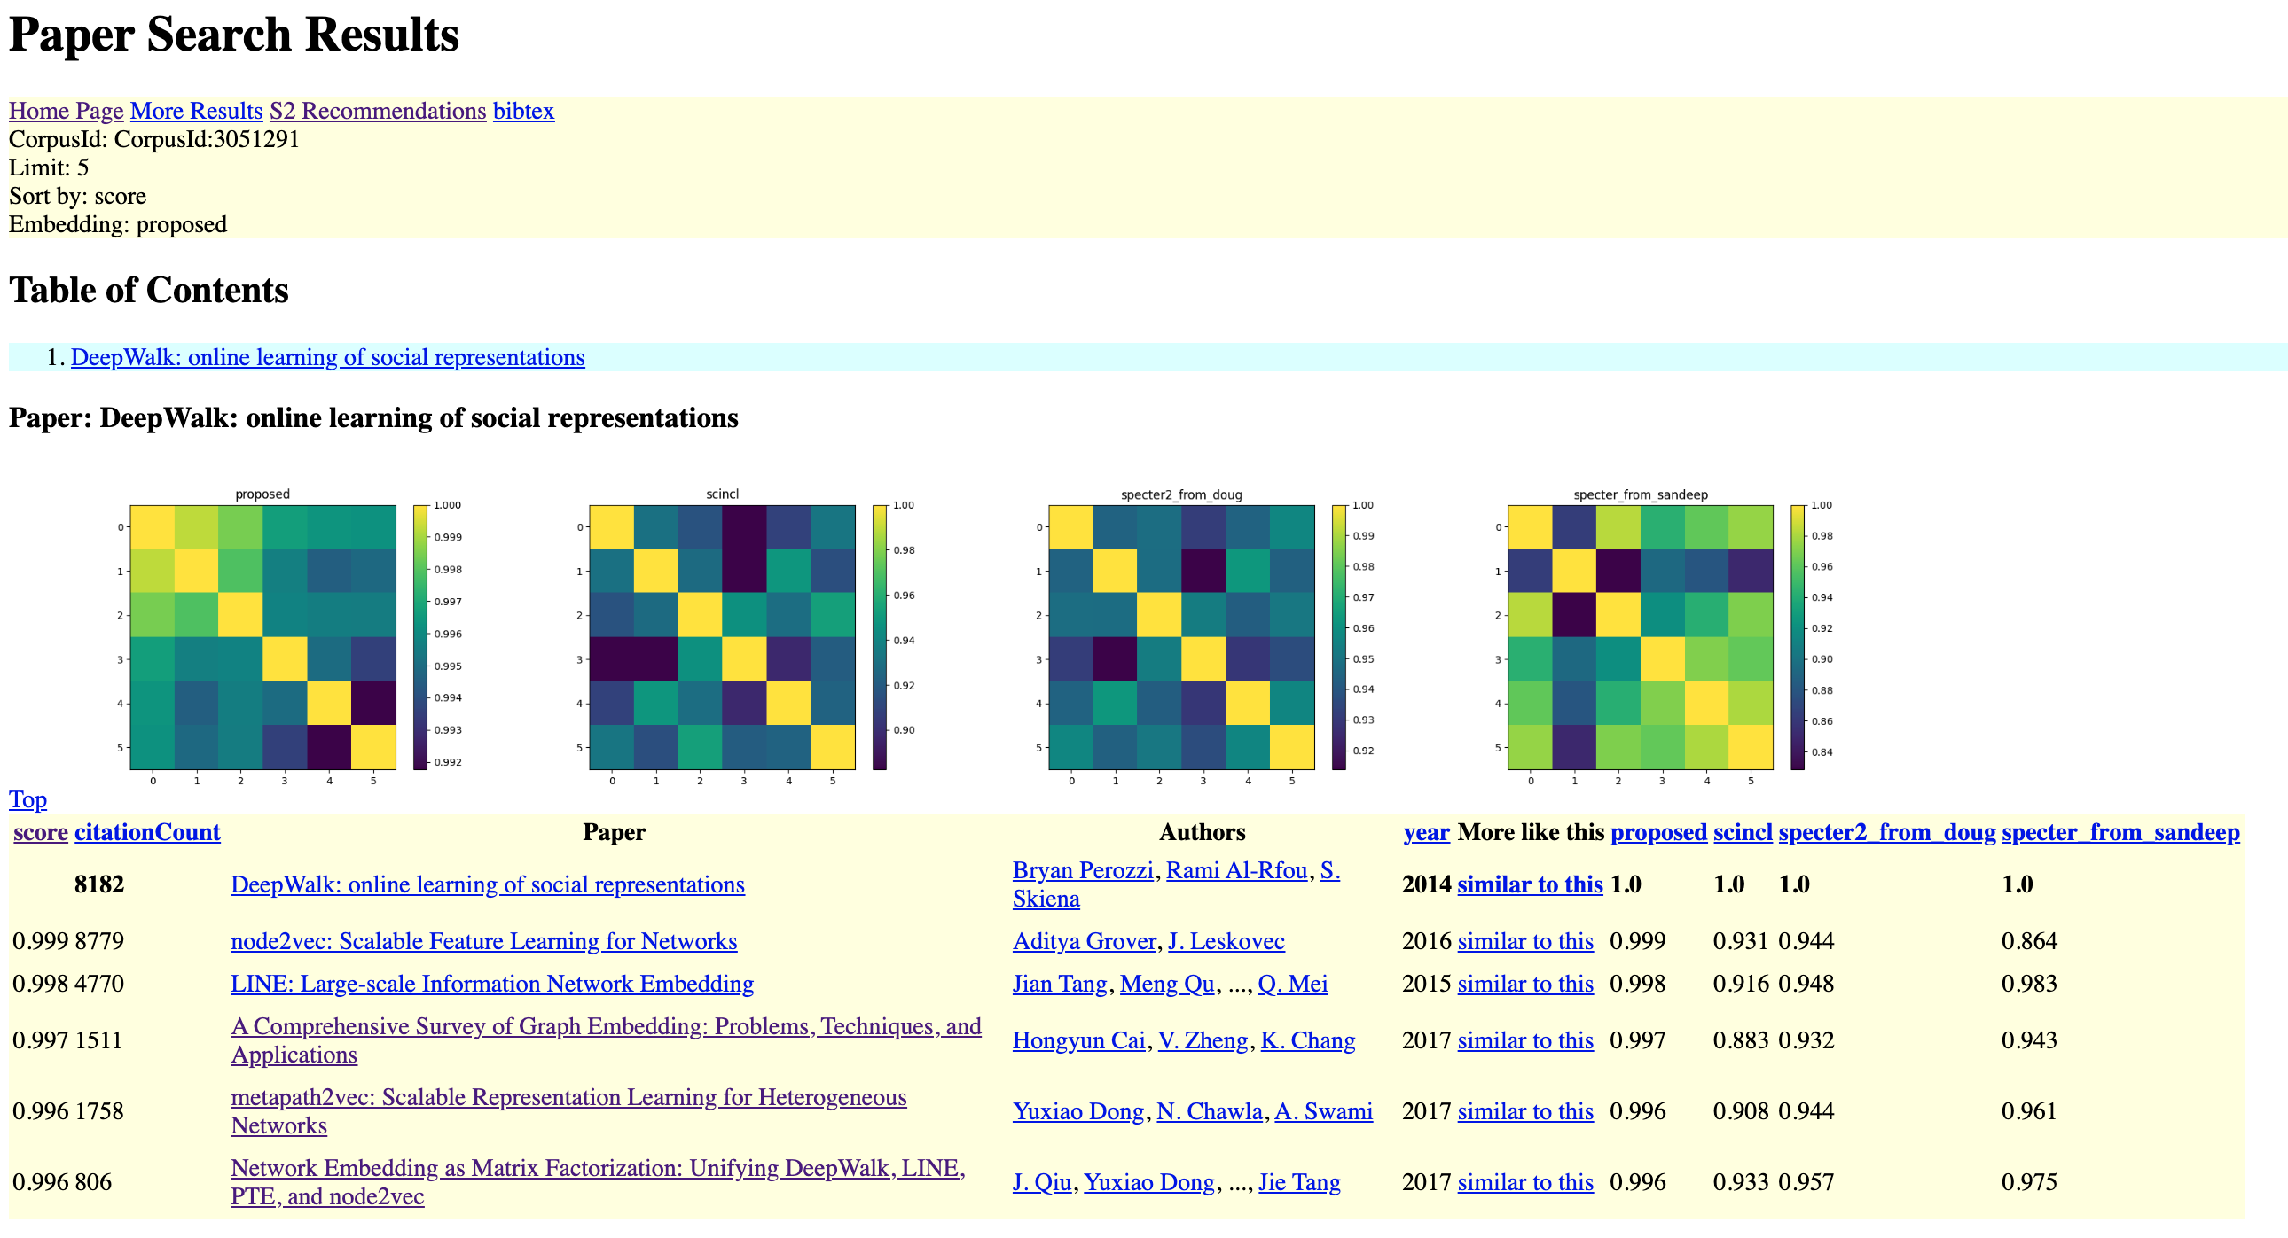
Proposed Method

Slide 5
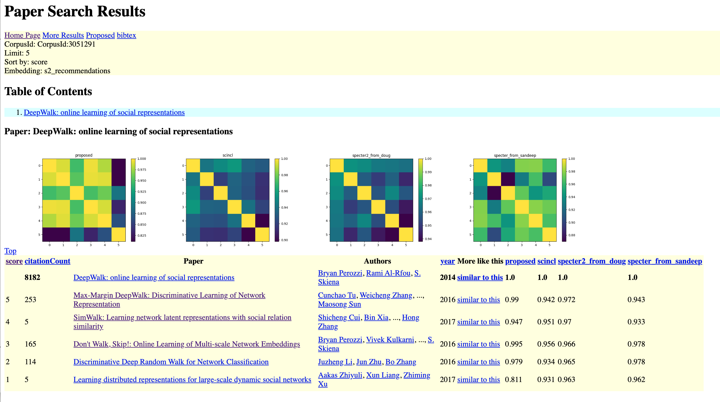
Recommendations from Semantic Scholar

Slide 6
Prior: More citations → More credible
Proposed
Semantic Scholar
Spectral Clustering of Citation Graph
BERT-like Deep Net

Slide 7
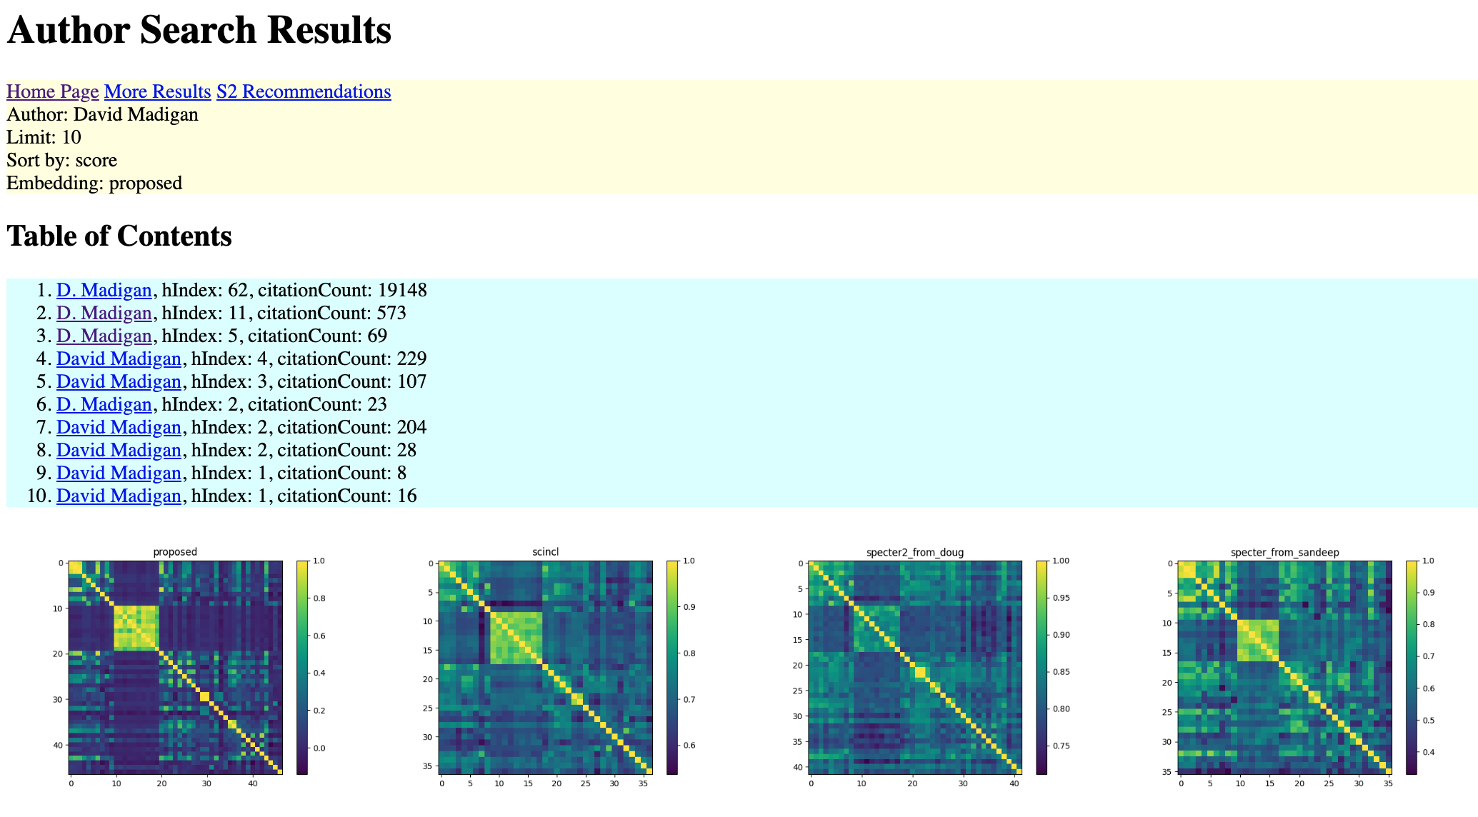
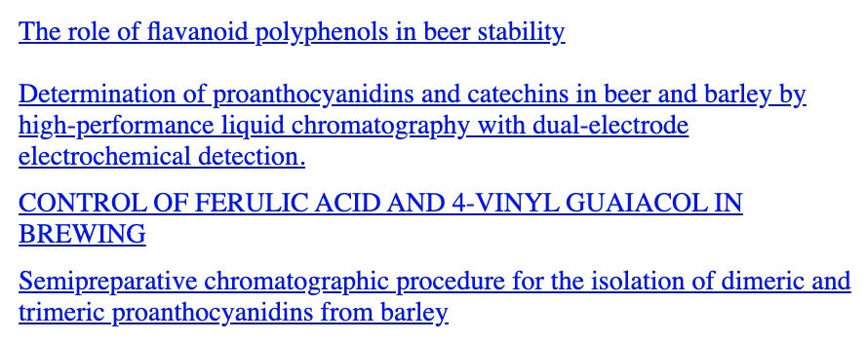

Slide 8
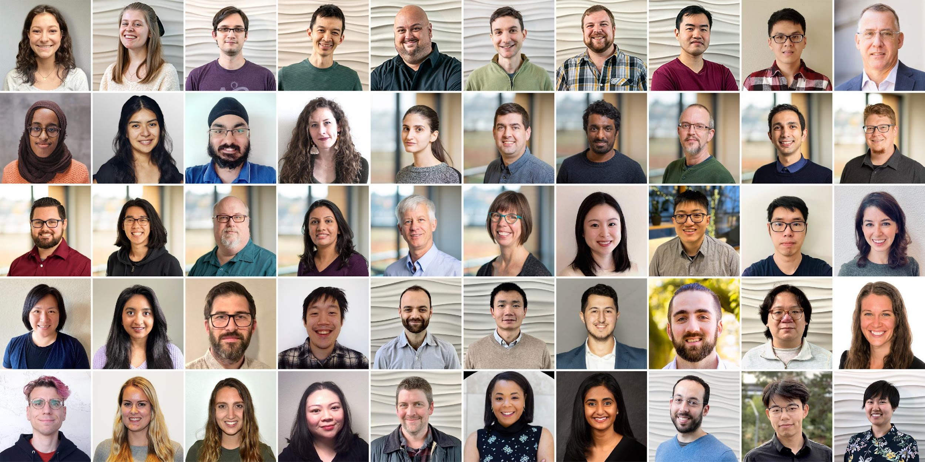
Semantic Scholar (S2): Significant Effort (slide from Dan Weld)
50 person team
7 year project
207M+ scientific paper index
8M+ monthly active users

Slide 9

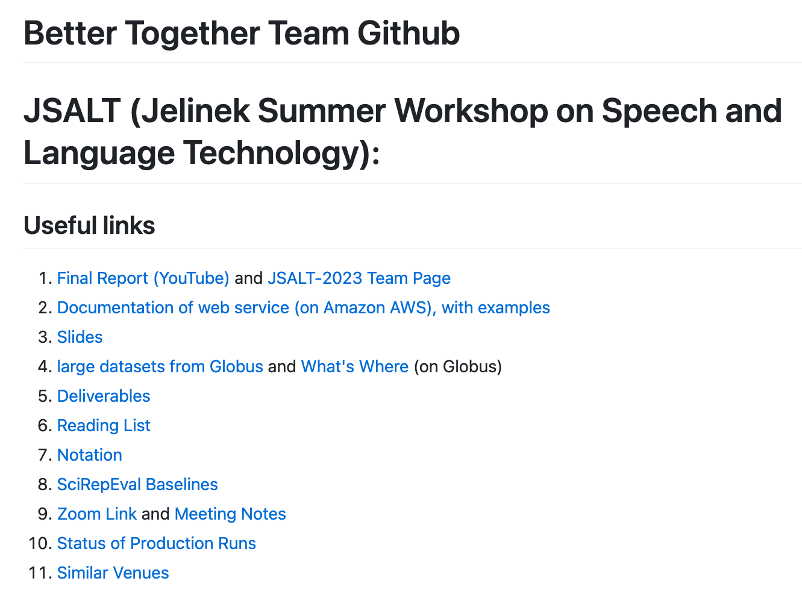
https://github.com/kwchurch/JSALT_Better_Together
YouTube
Web Page
including these slides

Slide 10

Better Together: Text (Titles, Abstracts, Body); Context (Citations)
Specter, SciNCL
ProNE

Slide 11
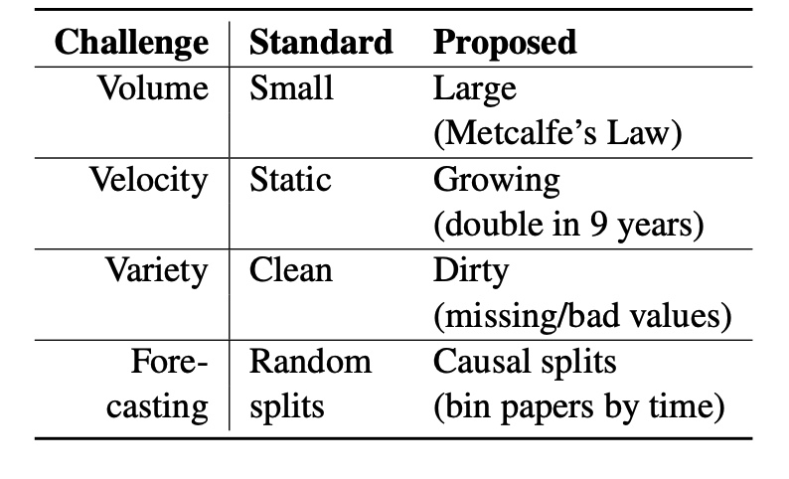
Standard benchmarks are small, static and clean

Slide 12


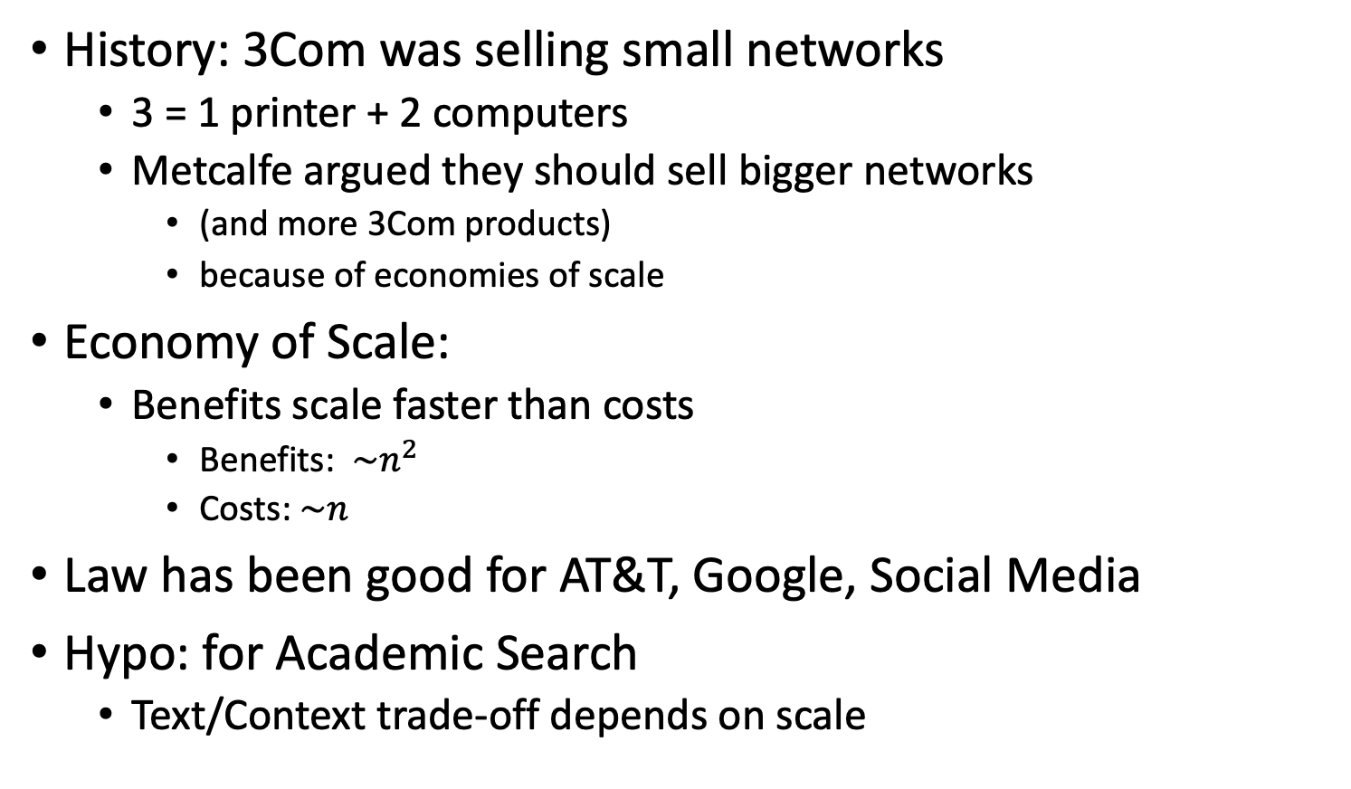
Metcalfe’s Law (Network Effects)
History: 3Com was selling small networks
3 = 1 printer + 2 computers
Metcalfe argued they should sell bigger networks
(and more 3Com products)
because of economies of scale
Economy of Scale:
Benefits scale faster than costs
Benefits: $\sim n^{2}$
Costs:$\sim n$
Law has been good for AT&T, Google, Social Media
Hypo: for Academic Search
Text/Context trade-off depends on scale

Slide 13
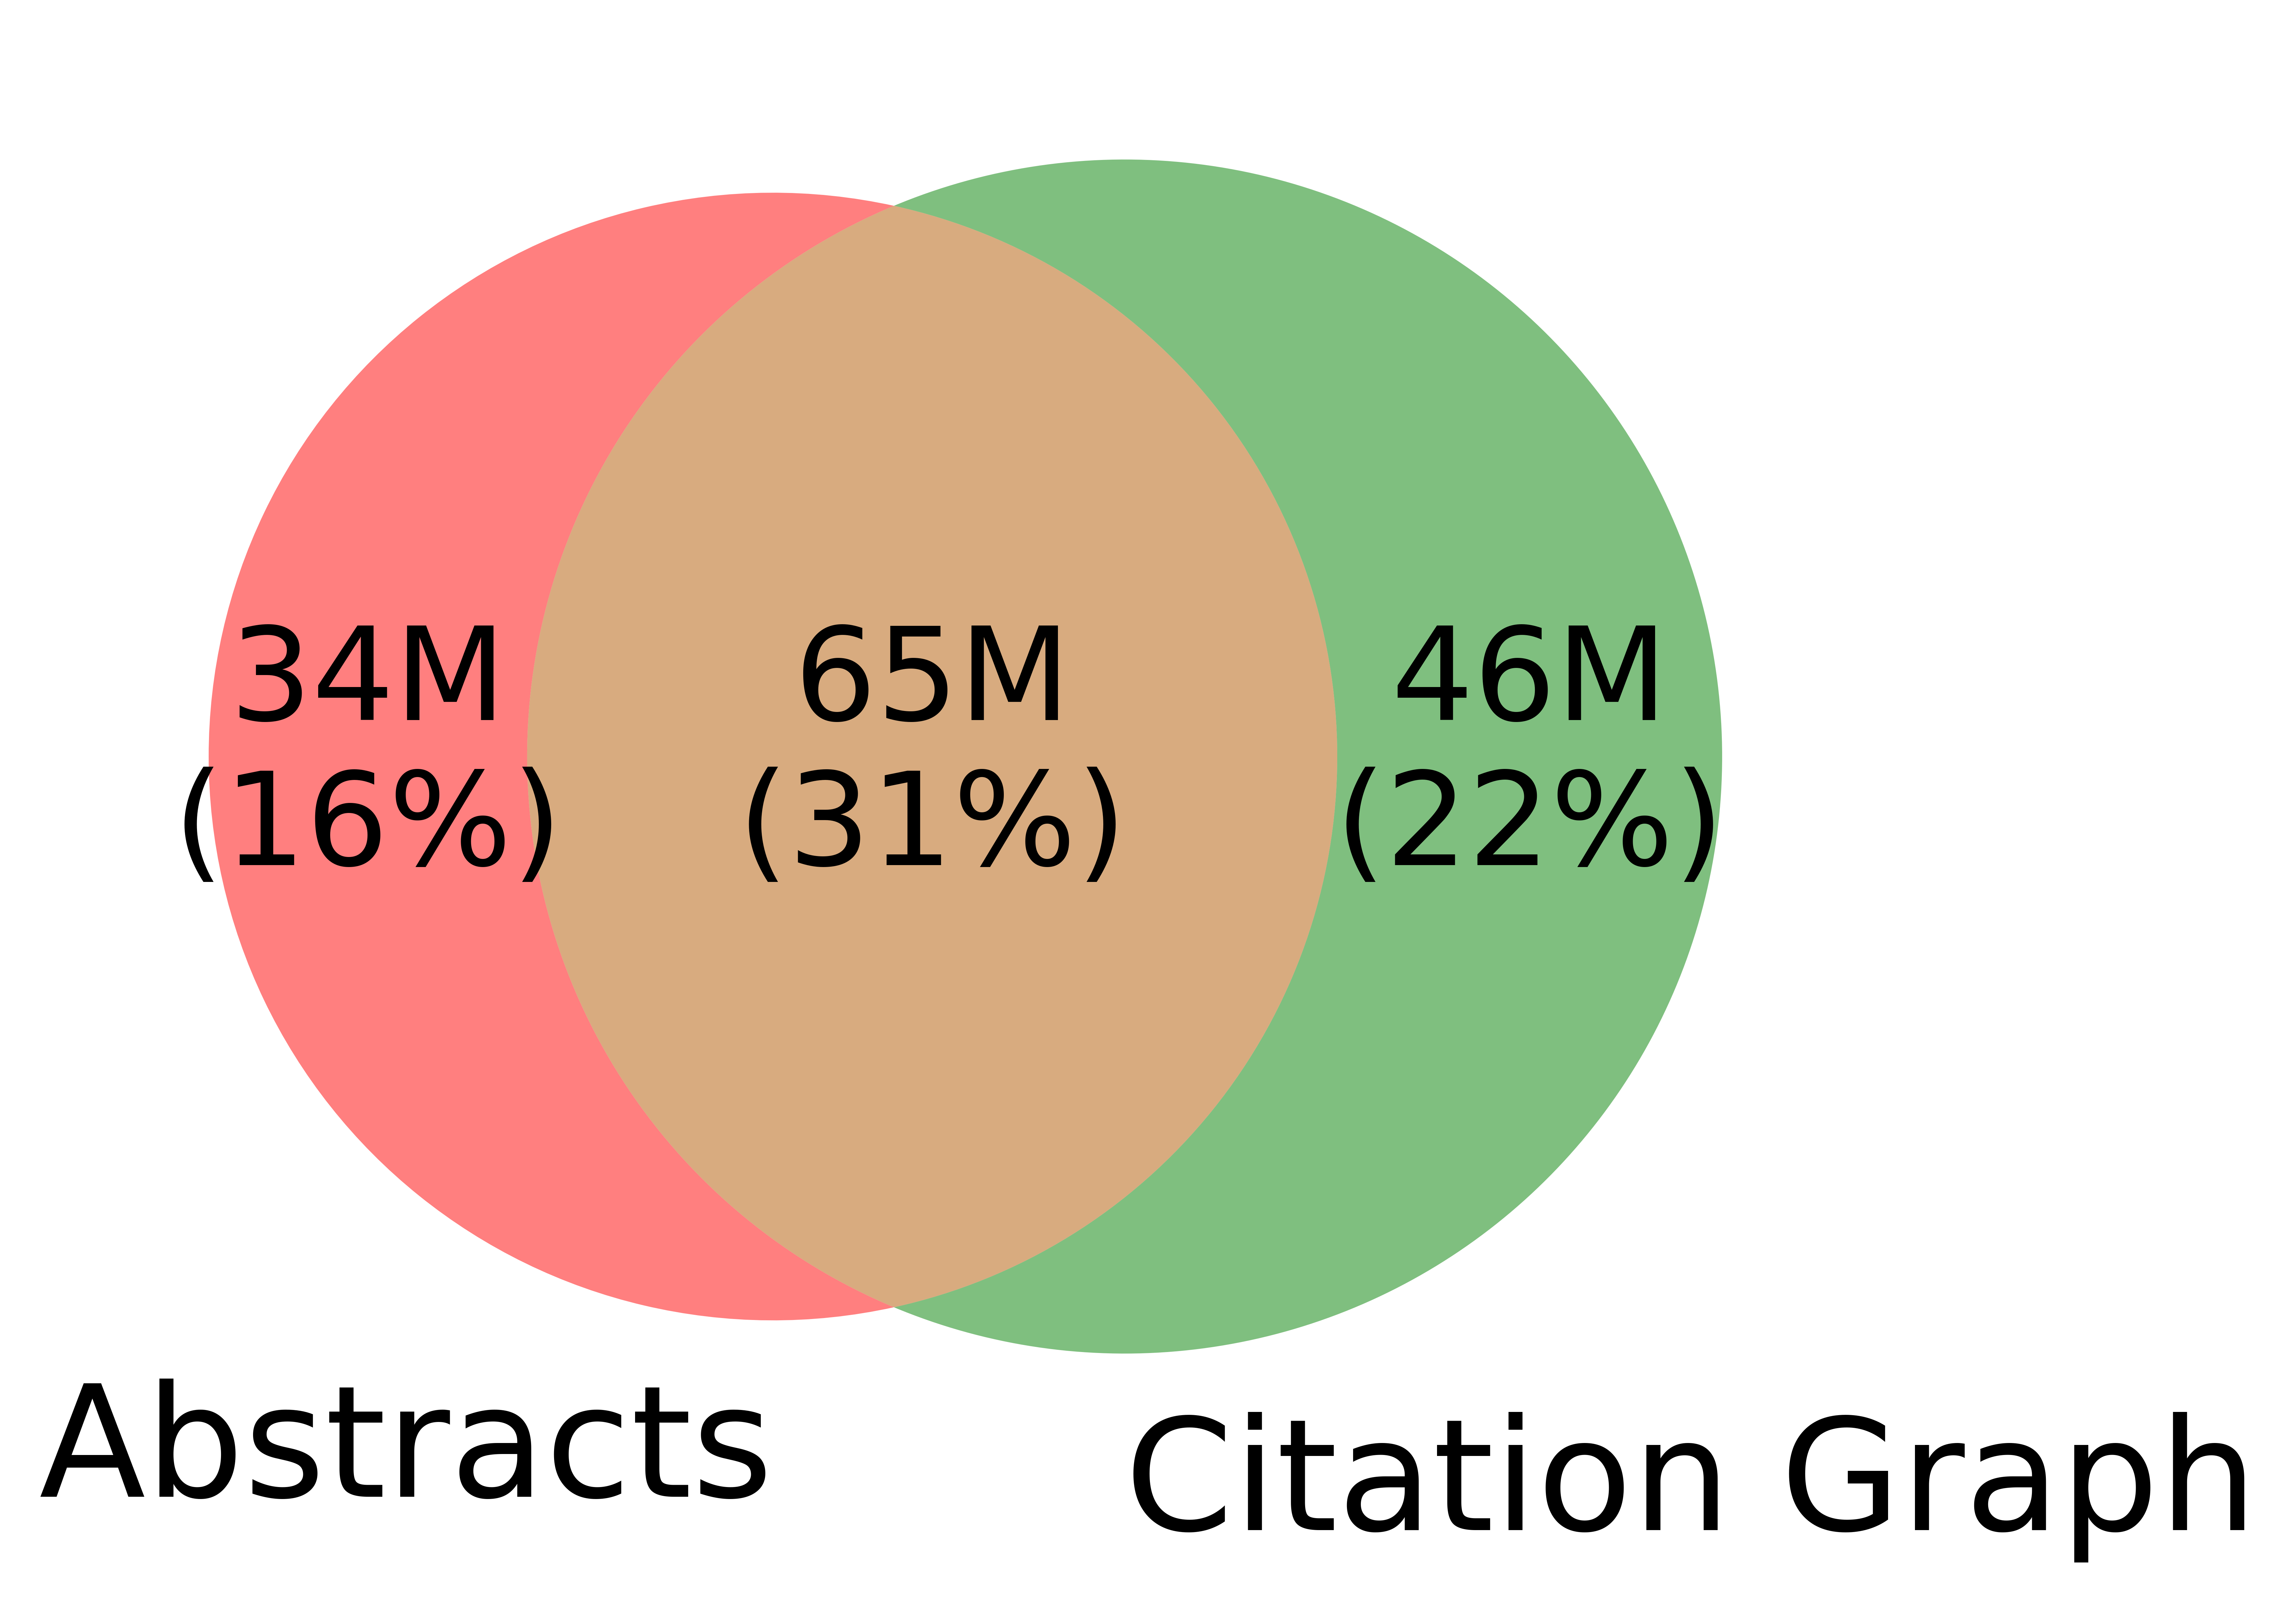
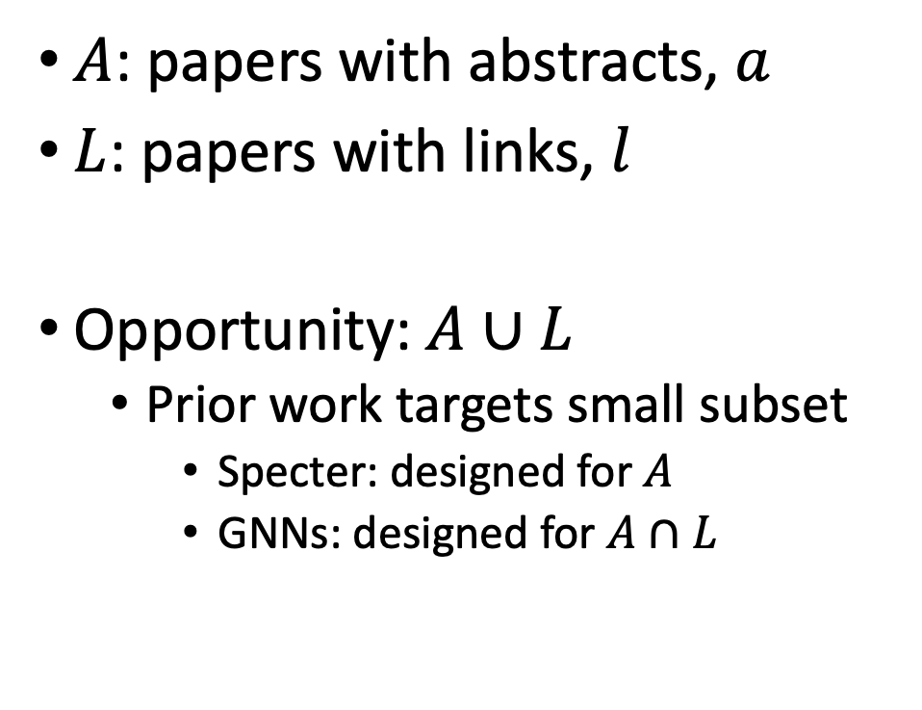
Realities (Dirty): Missing Values
$A$: papers with abstracts, $a$
$L$: papers with links, $l$
Opportunity:$A∪L$
Prior work targets small subset
Specter: designed for $A$
GNNs: designed for $A∩L$
Other
31%

Slide 14
Better-Together Conjectures
Multiple representations are helpful
for missing values (and bad values)
If abstracts are missing, use links
If links are missing, use abstracts
and for graphs of different sizes
When graphs are small:
Text >> Links
when graphs are large:
Links >> Text (Metcalfe’s Law)

Slide 15
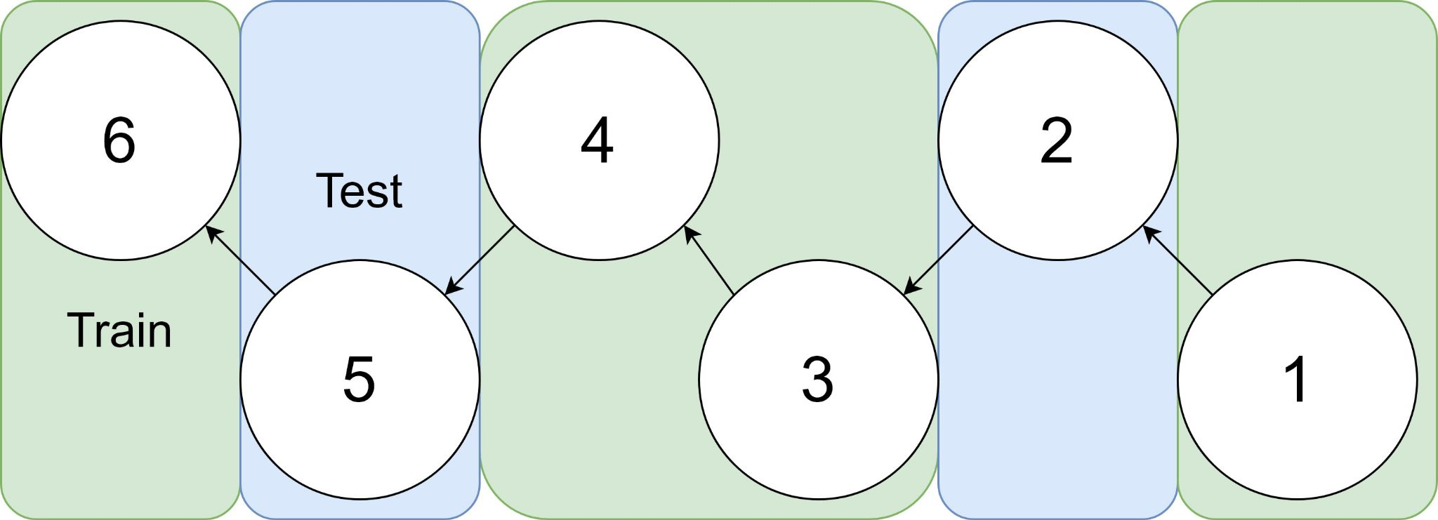
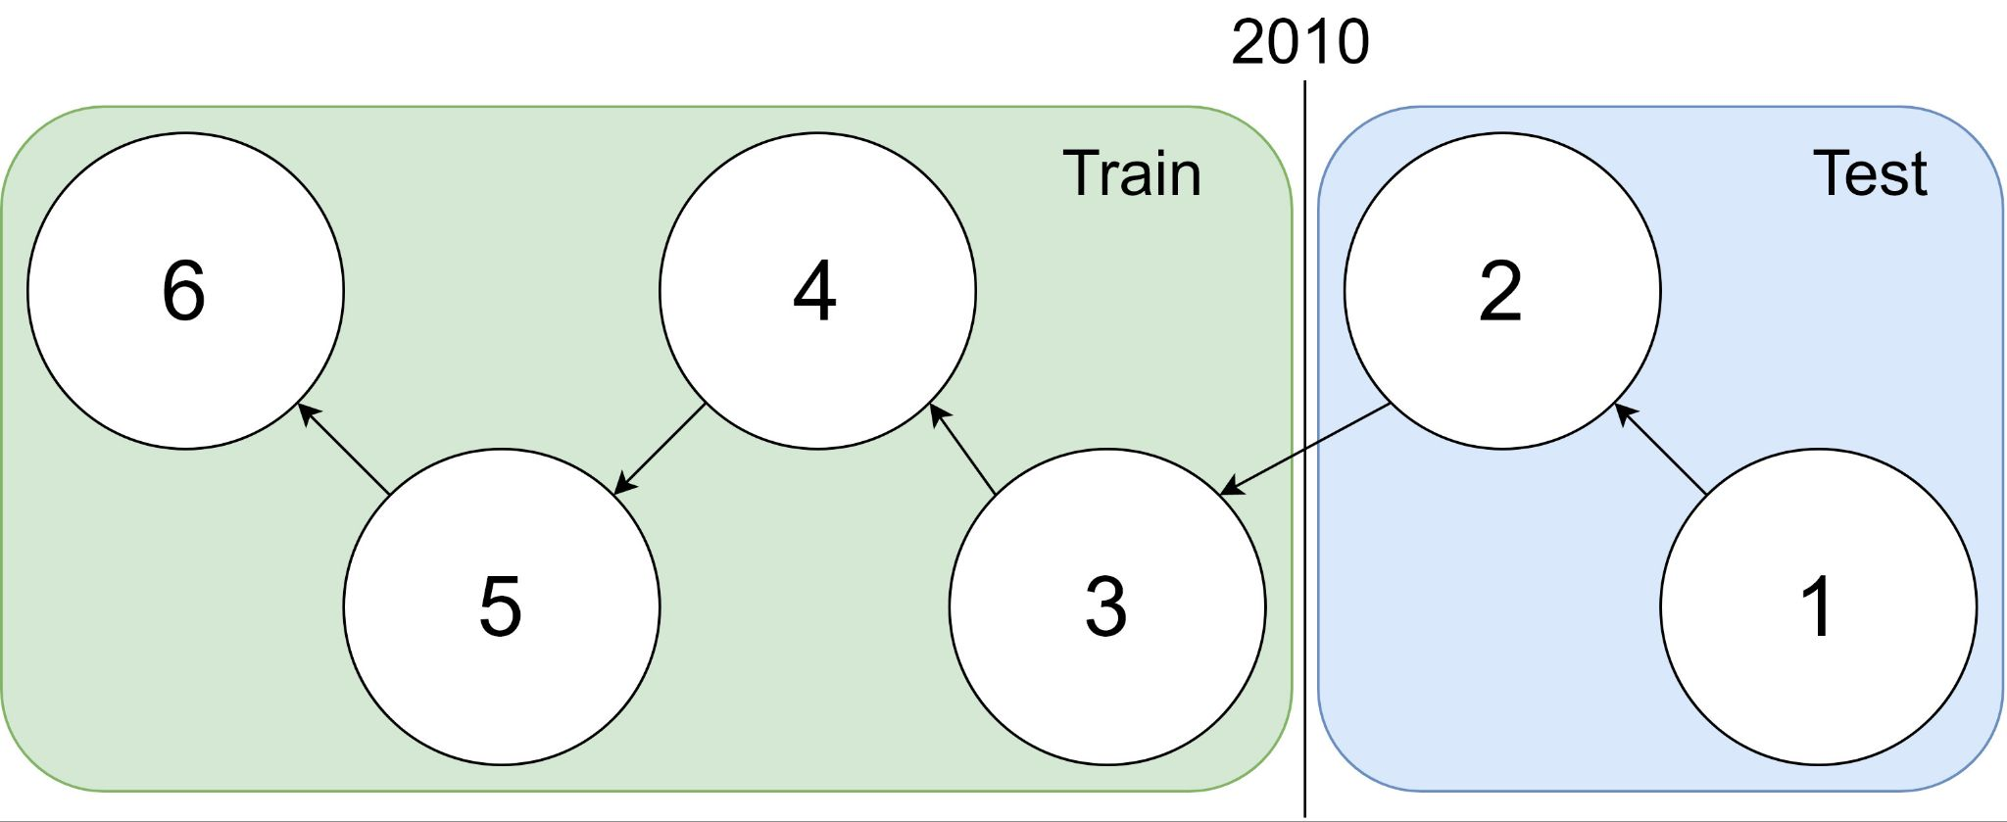
Example: 1 cites 2, 2 cites 3, … 5 cites 6
Traditional Train-Test Split (Non-Causal)
idx | Pub Year | Paper Title
1 | 2018 | [...] Photofragment imaging
2 | 2016 | Convenient probe of S(1D2)[...]
3 | 2005 | Megapixel ion imaging [...]
4 | 2003 | Direct current slice imaging [...]
5 | 1995 | profiles of Cl(2Pj) photofragments [...]
6 | 1988 | Adiabatic dissociation of [...]
Proposed Train-Test Splits (Causal)
Notes:
No asymmetry of time - how to reduce to a soundbite
Audience soundbites
‘Almost all studies in ml do test-train split’ that’s a bad idea when you have time

Slide 16
Opportunities
Scale
Forecasting
Many benchmarks return a single number (figure of merit)
How does performance scale
with the size of the problem?
Standard test/train splits
More relevant to interpolation
than extrapolation
Time is asymmetric
It is difficult to make predictions
especially about the future
-- Yogi Berra

Slide 17
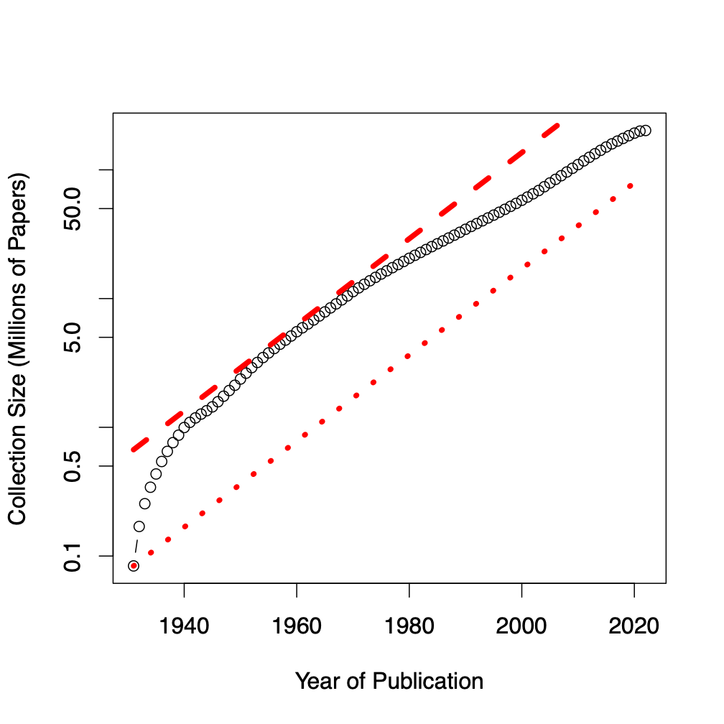
Assign 200M papers to 100 bins (by time)
Sort 200M papers by publication date
Output: Split papers into 100 bins, with 2M papers/bin
Because of exponential growth
(literature doubles every 9 years)
older bins span more time, and
newer bins span less time
Bin 99
………
Bin 0
Time
90% of literature published after I went to grad school
Notes:
mention equal # papers
consider replacing w/ diagram

Slide 18
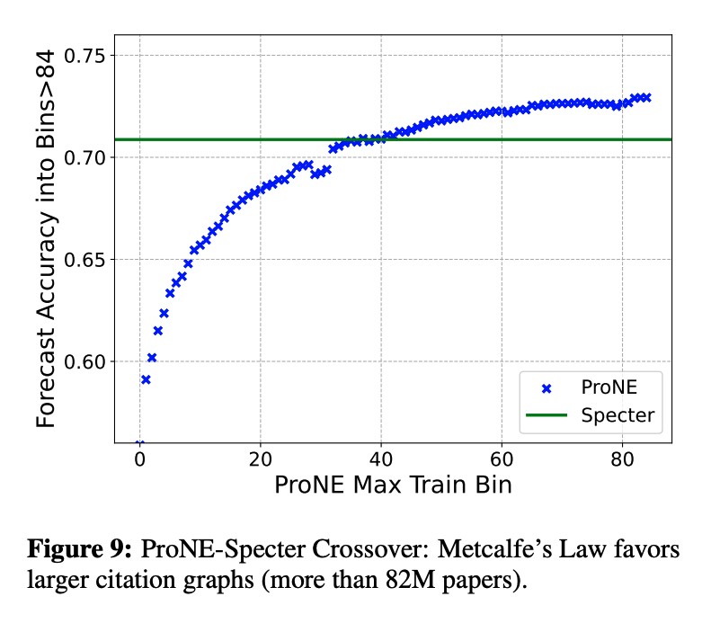
Experimental Results
Performance improves
when training set is larger and spans more time
Performance degrades
with predictions further and further into the future
Because of Metcalfe’s Law
Text/Context trade-off
Depends on scale
Larger graphs favor context
ProNE: Spectral clustering on citations
Specter: BERT-like encoding of text
Better-Together
Ensembles >> Either by itself

Slide 19
Conclusion: Deliverables
GitHub:
massive (but needs editing)
slides, code, reading list
pointers to large files on Globus
Web Server
Recommendations
Input: queries (docs)
Output: recommendations (docs)
What Should I read? Cite?
Resources
Data behind web server:
citation graph
embeddings
indexes for approx. nearest neighbors
pairs of corpusIds with large cosines
all of the above for
Specter1, Specter2, SciNCL, ProNE
x100 bins for ProNE
Evaluations & Benchmarks
Intrinsic: Perplexity, Random Walks
Extrinsic: Local Citation Prediction

